Slide 1
Crimean-Congo haemorrhagic feve
By Assit. Prof Dr. Hussein Al Naji

Slide 2
Overview
Crimean-Congo haemorrhagic fever (CCHF) is a widespread disease caused by a tick-borne virus (Nairovirus) of the Bunyaviridae family. The CCHF virus causes severe viral haemorrhagic fever outbreaks, with a case fatality rate of 10–40%.
CCHF is endemic in Africa, the Balkans, the Middle East and Asian countries south of the 50th parallel north – the geographical limit of the principal tick vector.

Slide 3
CCHF in Animals & Ticks
The hosts of the CCHF virus include a wide range of wild and domestic animals such as cattle, sheep and goats. Many birds are resistant to infection.
Animals become infected by the bite of infected ticks and the virus remains in their bloodstream for about one week after infection, allowing the tick-animal-tick cycle to continue when another tick bites. Although a number of tick genera are capable of becoming infected with CCHF virus, ticks of the genus Hyalomma are the principal vector.

Slide 4
Transmission
Human-to-human transmission can occur resulting from close contact with the blood, secretions, organs or other bodily fluids of infected persons. .
The CCHF virus is transmitted to people either by tick bites or through contact with infected animal blood or tissues during and immediately after slaughter.
The majority of cases have occurred in people involved in the livestock industry, such as agricultural workers, slaughterhouse workers and veterinarians.

Slide 6
Clinical features of CCHF disease
The incubation period ranges from 2-14 days.
• 70% of CCHF cases have a history of tick bite.
• It is estimated that 88% of infections are subclinical.
• Case fatality ratio can reach 15% among patients hospitalized with severe presentation.
• Most common symptoms include:
• Abrupt onset fever, chills, shudders, myalgia, headaches, sicknesses and vomits, abdominal pain, arthralgia;
• After a few days: bleeding from mucous membranes, hematomas, ecchymosis, melena, hematuria, nose bleeding, vaginal bleeding, bradycardia, thrombocytopenia,
leukopenia

Slide 7
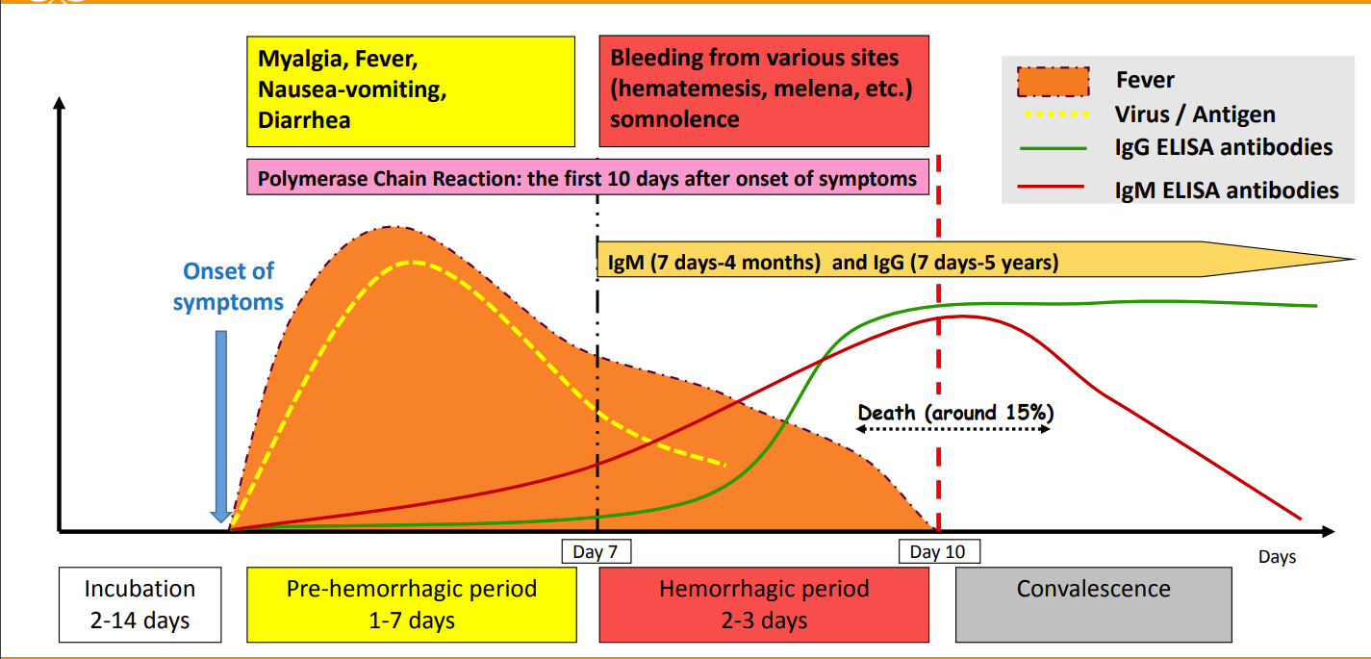

Slide 8
• Symptoms are non-specific; clinical diagnosis may be difficult.
• Differential diagnosis includes other viral haemorrhagic fevers, malaria, typhoid fever, shigellosis, and other
viral and bacterial diseases.
• Patient history is essential and should include:
➢ exposure to ticks;
➢ or exposure to wild animals and livestock;
➢ and/or area/village endemic for CCHF;
➢ and/or contact with CCHF cases.

Slide 9
Definitive diagnosis requires testing:
• reverse transcriptase polymerase chain reaction (RT-PCR) assay;
• IgG and IgM antibodies enzyme-linked immunosorbent assay (ELISA);
• antigen detection tests;
• virus isolation by cell culture.

Slide 10
Controlling CCHF in animals and ticks
Public health advice should focus on several aspects.
A- Reducing the risk of tick-to-human transmission:
1- wear protective clothing (long sleeves, long trousers);
2- wear light coloured clothing to allow easy detection of ticks on the clothes;
3- use approved acaricides (chemicals intended to kill ticks) on clothing;
4- use approved repellent on the skin and clothing;
5- Regularly examine clothing and skin for ticks; if found, remove them safely;
6- Seek to eliminate or control tick infestations on animals or in stables and barns.
7=- Avoid areas where ticks are abundant and seasons when they are most active seasons when they are most active.

Slide 11
Reducing the risk of animal-to-human transmission:
wear gloves and other protective clothing while handling animals or their tissues in endemic areas, notably during slaughtering, butchering and culling procedures in slaughterhouses or at home;
quarantine animals before they enter slaughterhouses or routinely treat animals with pesticides two weeks prior to slaughter.
Reducing the risk of human-to-human transmission in the community:
avoid close physical contact with CCHF-infected people;
wear gloves and protective equipment when taking care of ill people;
wash hands regularly after caring for or visiting ill people.

Slide 12
THANK YOU!
DR H.N
Phone
Email

